Slide 1
Project PRESENTATION
UIT2511 Software Development Project - II

Slide 2
GUAVA DISEASE CLASSIFICATION AND PREDICTION A project by PMK

Slide 3
TEAM MEMBERS
Kezia Stephano, 31222225002059
Moneeka S, 31222225002076
Pranesh Kumar S P, 3122225002094

Slide 4
PROBLEM STATEMENT
Accurate detection and classification of abnormalities in ECG signals are essential for reliable cardiac monitoring, yet current methods often struggle with signal variability and noise.
This project proposes a robust signal processing pipeline using Long Short-Term Memory (LSTM) networks, combining R-peak detection, wavelet transformation, and dimensionality reduction to enhance the accuracy and reliability of automated ECG classification, supporting improved cardiac diagnostics.

Slide 5
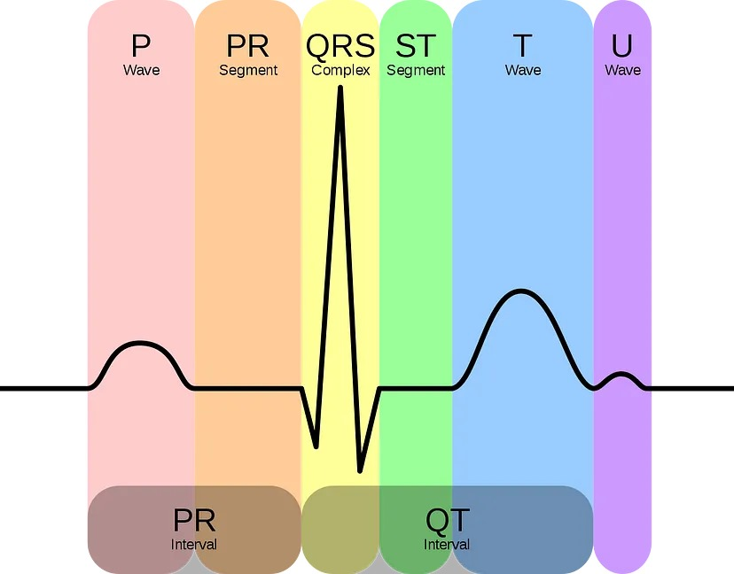
OBJECTIVE
Preprocess ECG signals
Apply Wavelet Transform
Dimensionality Reduction with PCA
LSTM Classification
Evaluate Model Performance

Slide 6
CLIENT DETAILS
Client complete affiliation
Email: durgadeviv@ssn.edu.in

Slide 7
REQUIREMENT ENGINEERING
REQUIREMENT COLLECTION
List of Requirements:
Software: Python, TensorFlow/Keras, NumPy, SciPy, Scikit-learn
Data: ECG dataset, ground truth annotations
Model: LSTM for classification, wavelet transform, PCA
Tools: Preprocessing, evaluation tools
Documentation: Report and presentation

Slide 8
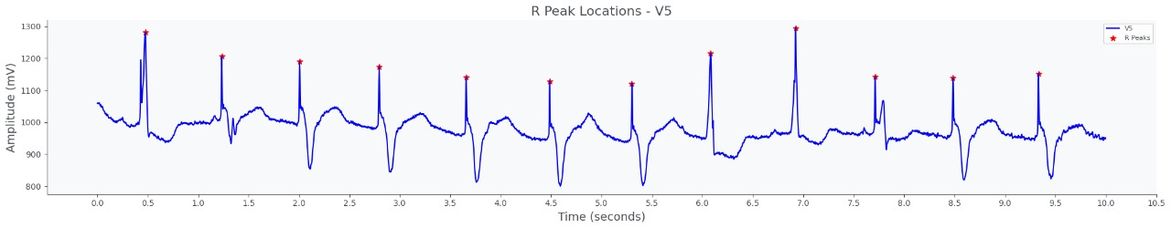
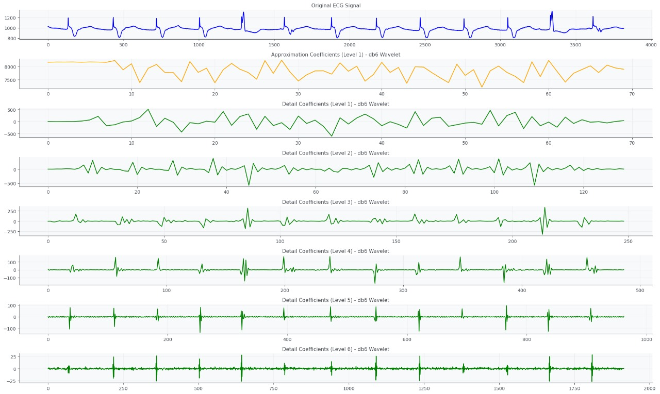
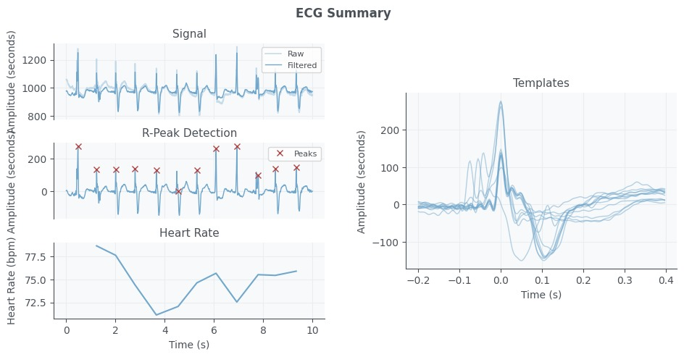
FUNCTIONAL REQUIREMENTS
NON-FUNCTIONAL REQUIREMENTS
ECG Signal Acquisition: read ECG signals and annotations from database.
Signal Preprocessing: Detect P, Q, R, S, T waves and segment around the R-peak.
Wavelet Transform: Decompose ECG signals using Daubechies wavelet.
PCA: Apply dimensionality reduction to processed data.
LSTM Classification: Classify ECG abnormalities into 5 categories.
Performance Evaluation: Measure classification accuracy.
Computational Efficiency - The algorithm should be optimized for real-time of ECG data.
Scalability
Usability
Reproducibility
Model Accuracy
Robustness
Documentation

Slide 9




OTHER IMPLEMENTATION DETAILS
Bank end used:
Python libraries for
data processing (biosppy, wfdb),
machine learning (TensorFlow, scikit-learn), and
signal processing (PyWavelets).
Data Structures used :
Lists,
NumPy arrays,
Pandas DataFrames, and
Dictionaries.
Other files used : Files associated with input data (ECG signals and annotations), and output files (model files and label encoder).
Total Number of sprints taken: 5

Slide 10
OTHER IMPLEMENTATION DETAILS
Sprint EESPUA-11: 1 week
Requirements Collection, R&D, Presentation
Sprint EESPUA-13: 2 weeks
Phase 1 Review, Prototype 1, Documentation
Sprint EESPUA-14: 3 weeks
R-Peak Detection, Wavelet Transform, Signal Energy
Sprint EESPUA-16: 1 week
Principal Component Analysis
Sprint EESPUA-17: 4 weeks
LSTM Model, Dimensionality Reduction, Train & Test Model

Slide 11
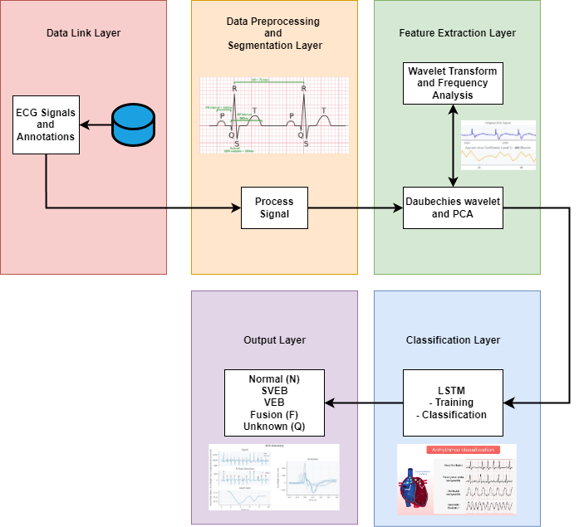
DESIGN DETAILS

Slide 12
INDIVIDUAL CONTRIBUTION
1. Team member name: Kezia Stephano
Work description : Data Collection, coding, documentation
Worked on: data acquisition, preprocessing, feature extraction, signal analysis, implements the LSTM model for classification and result output.
2. Team member name: Moneeka S
Work description : Data Collection, coding, documentation
Worked on: data acquisition, preprocessing, feature extraction, signal analysis, implements the LSTM model for classification and result output.
3. Team member name: Pranesh Kumar S P
Work description : Data Collection, coding, documentation
Worked on: data acquisition, preprocessing, feature extraction, signal analysis, implements the LSTM model for classification and result output.

Slide 13
IMPLEMENTATION DETAILS
Sprint # | Epic | User Story # | Remarks on implementation
EESPUA-11 | Requirements Collection | Retrieve all essential requirements | DONE
EESPUA-13 | Phase 1 - Review | Prepare Prototype 1 | DONE
EESPUA-14 | Signal Processing | Implement R-Peak Detection | DONE
 |  | Develop Wavelet Transform | DONE
 |  | Calculate Signal Energy | DONE

Slide 14
IMPLEMENTATION DETAILS
Sprint # | Epic | User Story # | Remarks on implementation
EESPUA-16 | Principle Component Analysis | Perform PCA | DONE
EESPUA-17 | Develop LSTM Model | Dimensionality Reduction | DONE
 |  | Train Model | DONE
 |  | Test Model Accuracy | DONE

Slide 15
Risk Management
Data Quality Issues: Noise/artifacts.
Mitigation: Preprocessing (filtering, smoothing).
Computational Load: Slow processing.
Mitigation: Optimize and manage resources using PCA.

Slide 16
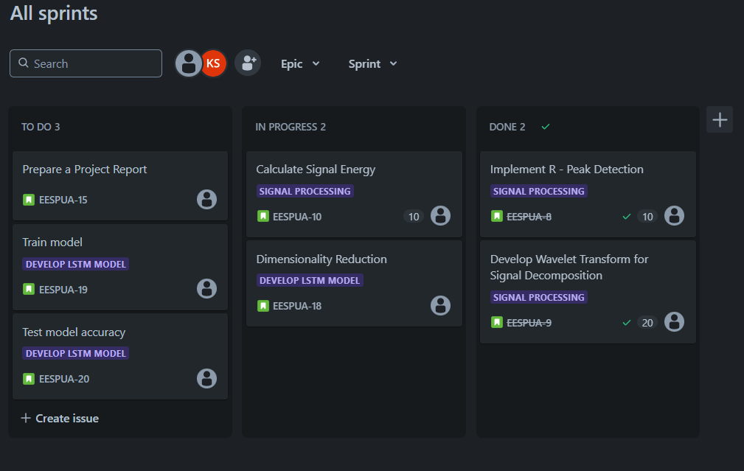
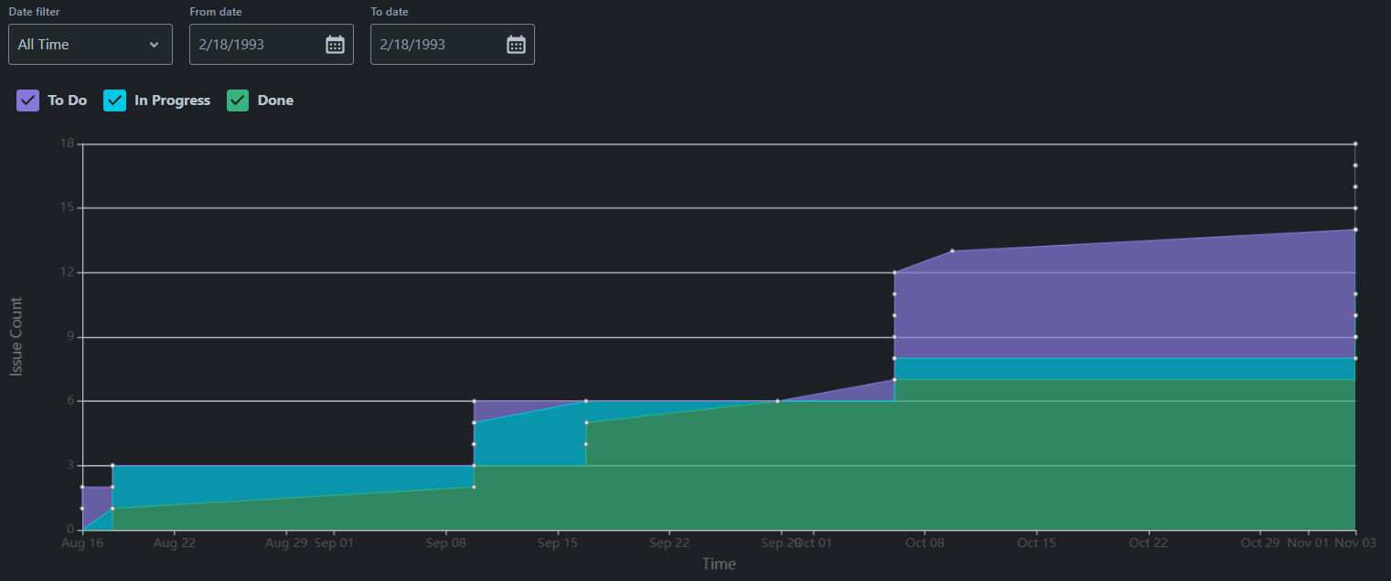
Test Log Report

Slide 17
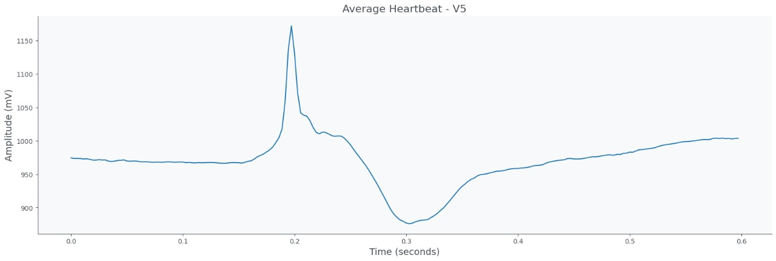
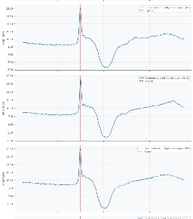
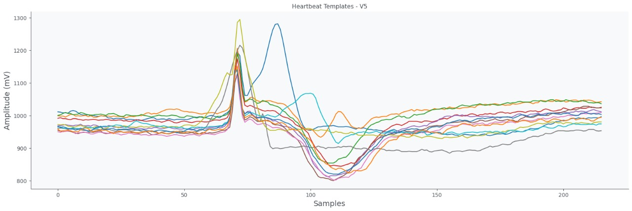
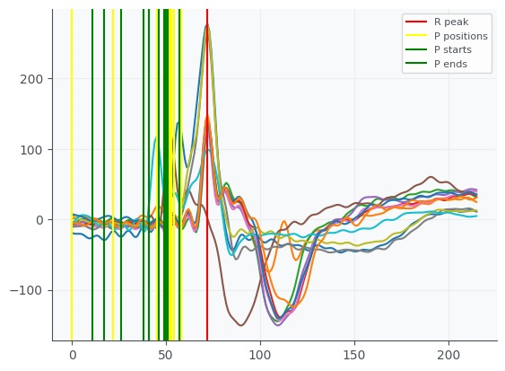
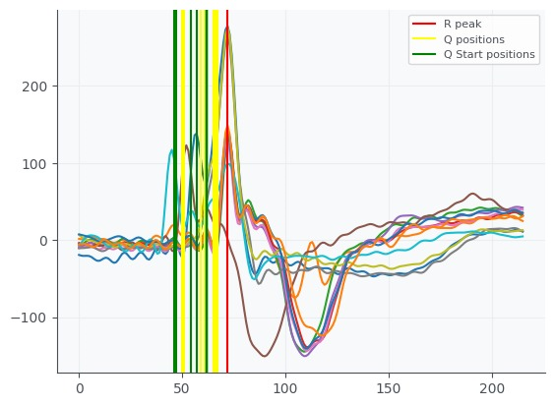
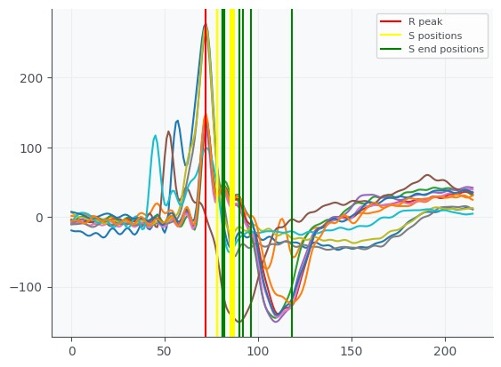
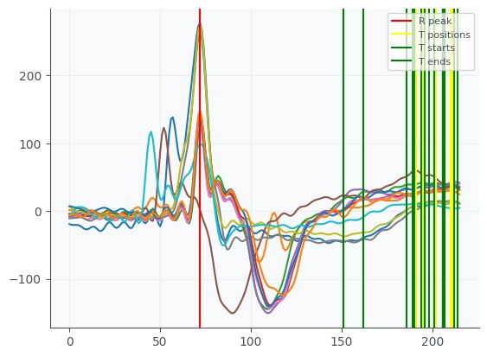
SCREENSHOTS OF TEST CASES OUTPUTS
Average heartbeat
Segmentation
Heartbeat template
P
Q
R
S

Slide 18
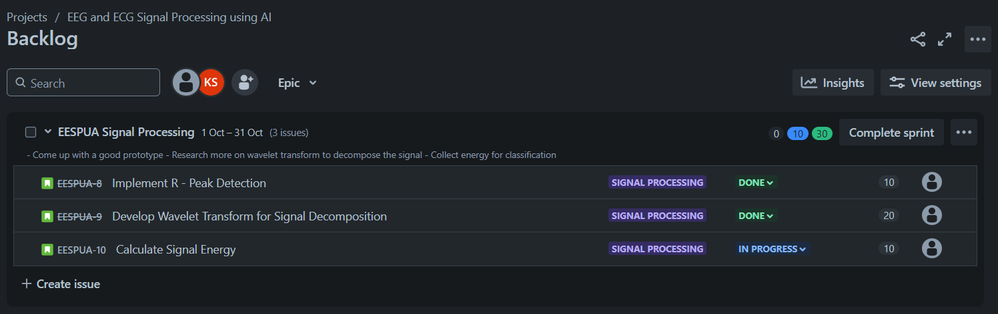
WORKING WITH JIRA SPRINT #4

Slide 19
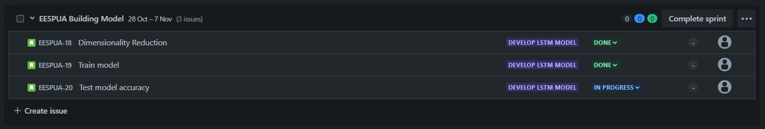
WORKING WITH JIRA SPRINT #5

Slide 20
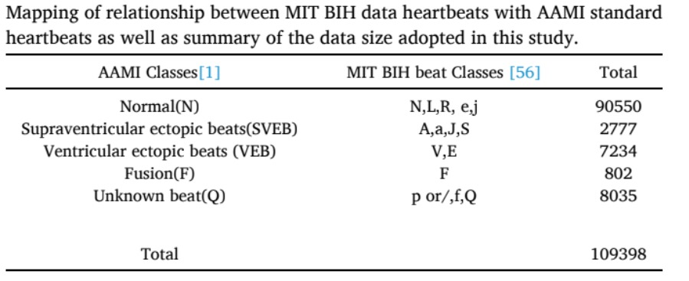
MEETING NOTES
Project Completed: Successfully implemented LSTM-based ECG classification for arrhythmias.
Key Accomplishments:
Preprocessed ECG data,
detected R-peaks, and segmented signals.
Applied wavelet transform and PCA for feature extraction.
Developed and tested LSTM model for classification.
Challenges Overcome:
Addressed noise and artifact issues in ECG signals.
Achieved optimal R-peak detection accuracy.
Results: Model classified ECG signals into 5 abnormality categories with high accuracy.

Slide 21
CREATING REPOSITORY
Code integrated with JIRA tool using bit bucket

Slide 22
FEEDBACK FROM CLIENT

Slide 23
REFERENCES
Ramasamy, K., Balakrishnan, K., & Velusamy, D. (2020). Detection of cardiac arrhythmias from ECG signals using FBSE and Jaya optimized ensemble random subspace K-nearest neighbor algorithm. Journal of Electrical Engineering & Technology, 15(3), 1234-1242.
Ramasamy, K., Balakrishnan, K., & Velusamy, D. (2021). Classification of inter-patient’s cardiac arrhythmias in ECG signals with enhanced Jaya optimized TQWT parameters and stacked ensemble algorithm. Biomedical Signal Processing and Control, 67, 102547. [DOI: 10.1016/j.bspc.2021.102547]
Madona, P., Basti, R. I., & Zain, M. M. (2019). PQRST wave detection on ECG signals. International Journal of Electrical and Computer Engineering (IJECE), 9(5), 4312-4319. [DOI: 10.11591/ijece.v9i5.20234]
Tara, K., & Islam, M. H. (2019). Advances of cardiac state-inducing prototype and design of GUI to anatomize cardiac signal for ascertaining psychological working competence. Journal of Electrical Engineering & Technology, 14(2), 543-551. [DOI: 10.1109/JEET.2019.00089]
Karri, M., & Annavarapu, C. S. R. (2020). A real-time embedded system to detect QRS-complex and arrhythmia classification using LSTM through hybridized features. Proceedings of the IEEE International Conference on Communication and Electronics Systems (ICCES), 224-228. [DOI: 10.1109/ICCES48766.2020.9143036]

Slide 24
Thank You!

